Slide 1










厚德博学 敬业乐群
BUPT
北京邮电大学
活力﻿风PPT
Beijing University of Posts and Telecommunications
汇报人：XXX
时间：XX月XX日

Slide 2


目录
CONTENTS
Contents
01.
02.
03.
04.
Part One
Part Two
Part Three
Part Four
请输入标题
请输入标题
请输入标题
请输入标题
please enter a title
please enter a title
please enter a title
please enter a title
添加关键词
添加关键词
添加关键词
添加关键词

Slide 3






Military
Joint Sword-2024B
汇报人：计子毅

Slide 4

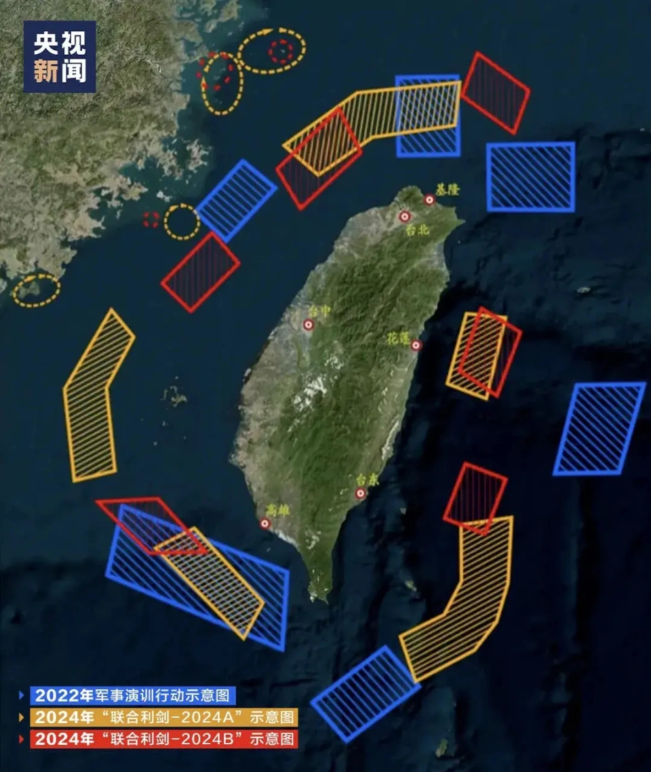
Joint Sword-2024B
Introduction
On October 14, the Chinese People's Liberation Army (PLA) Eastern Theater Command successfully concluded the "Joint Sword-2024B" military exercises, marking a significant milestone in its commitment to safeguarding national sovereignty and territorial integrity.
Senior Captain Li Xi, spokesperson for the PLA Eastern Theater Command, announced that the exercises had comprehensively tested the integrated joint operation capabilities of the theater's troops. Conducted in the Taiwan Strait, as well as northern, southern, and eastern parts of the Taiwan Island, the exercises involved land, naval, air, and rocket forces, showcasing the PLA's unwavering determination and formidable strength.
01.
02.
03.
04.
单击添加小标题内容，请尽量言简意赅的阐述你的观点

Slide 5

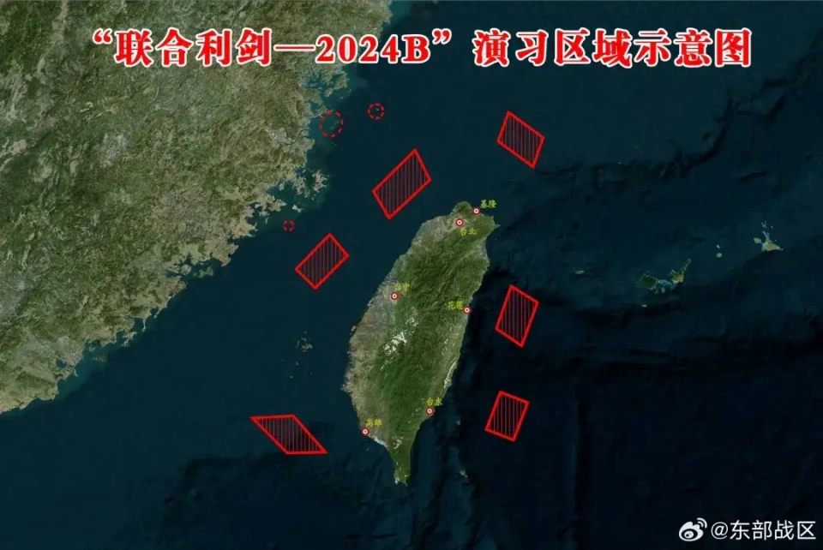

Process
During the exercises, various strategic targets, including key ports, air and sea domains, as well as outer islands, were subject to simulated blockades and strikes. This demonstrated the PLA's capability to establish comprehensive control over Taiwan, encompassing not just military operations, but also control over radio, electromagnetic waves, communications, water and power supplies, transportation hubs, and media platforms.
02
请输入标题

Slide 6
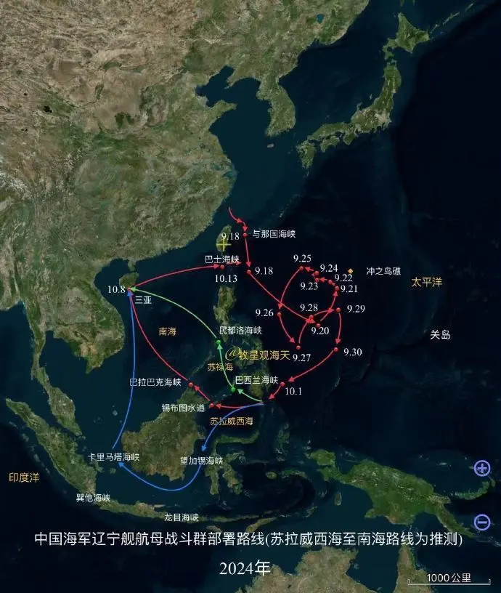
Meaning
The "Joint Sword-2024B" exercises were a direct response to the provocations by the "Taiwan Independence" forces, particularly the recent inflammatory speeches by Lai Ching-te, who has been advocating the "new two-state theory" and attempting to distort the historical facts of Taiwan being an integral part of China. The Ministry of National Defense and the Taiwan Affairs Office of the State Council emphasized that these exercises were a just act to defend national sovereignty and territorial integrity, and a strong deterrence against the "Taiwan Independence" separatists.
It is crucial to understand that these exercises were not aimed at the Taiwanese people, but rather at the "Taiwan Independence" separatists and their external supporters. The Chinese government has made it clear that while it is willing to strive for peaceful reunification with the utmost sincerity and effort, it will never promise to abandon the use of force and will leave no room for "Taiwan Independence."
National reunification brooks no delay

Slide 7
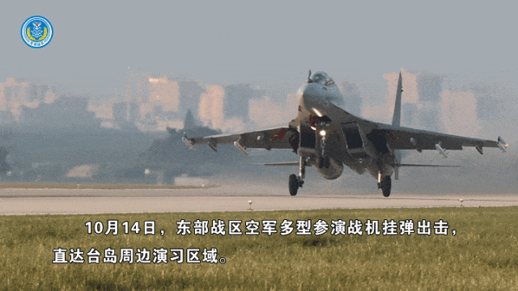



Summary
The "Joint Sword-2024B" exercises sent a clear message: any attempt at "Taiwan Independence" is a dead-end street. The PLA is fully prepared to take necessary actions to defend national sovereignty and territorial integrity. We call on all Taiwan compatriots to recognize the historical trend, stand on the right side of history, and join us in opposing "Taiwan Independence" and promoting reunification, so that we can share the glory of national reunification and national rejuvenation together.

Slide 8





Milestone
里程碑
Compatriot
同胞
Words
*The timing of linguistic milestones in sign language acquisition : are first signs acquired earlier than first words ?
*He was the one who was still hammering home belief in ultimate victory to his compatriots even when the war had long-since been lost.
常见搭配
① developmental milestone, key milestone
发展里程碑 关键的里程碑
② bond of compatriots, compatriot comrades-in-arms
同胞之情 同胞战友
③complete distortion，deliberate distortion
完全失真 故意扭曲
Rejuvenation
复兴
Distortion
歪曲
*Rejuvenation of the academic staff will doubtless also entail scientific modernization and make possible new forms of research and education
*Denying such consent any validity, and educating people in that conviction, could prevent such distortions.

Slide 9
厚德博学 敬业乐群
BUPT
THANK YOU
感谢你的观看

